Slide 1
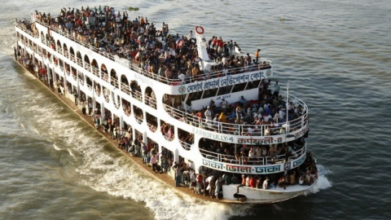
Effective Initiative to reduce transporter ship accident in Bangladesh

Slide 2
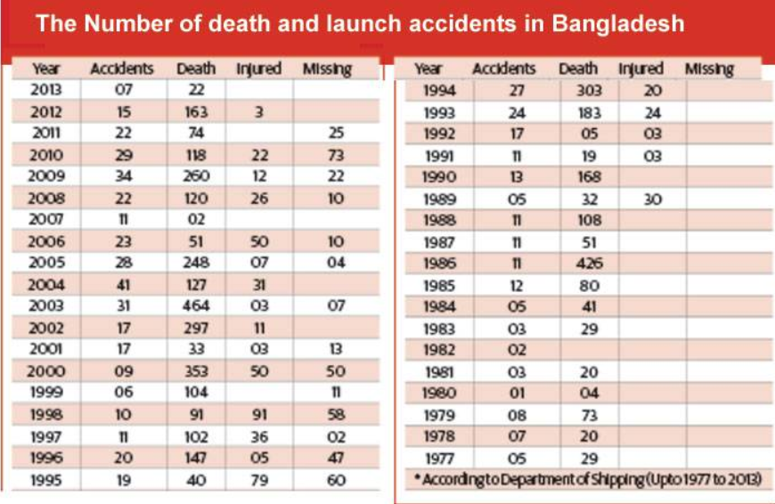
4,420 people died, 520 people injured and 400 people remained missing in more than 550 passenger launch accidents that took place in last 38 years

Slide 3
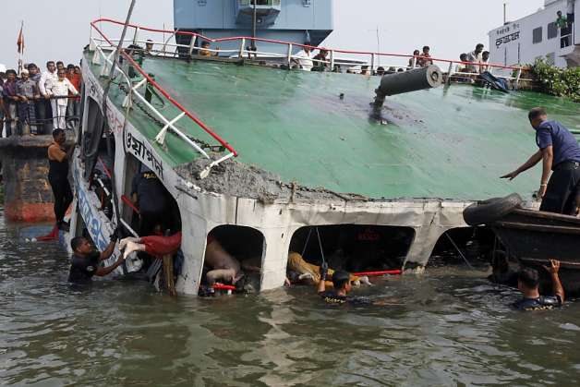
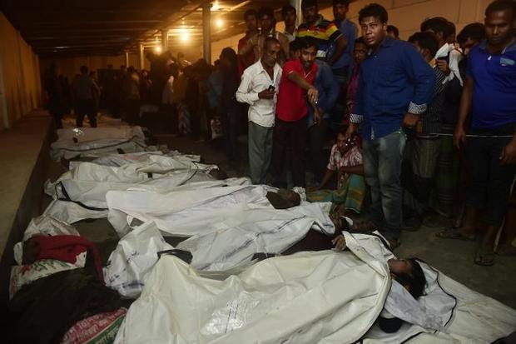
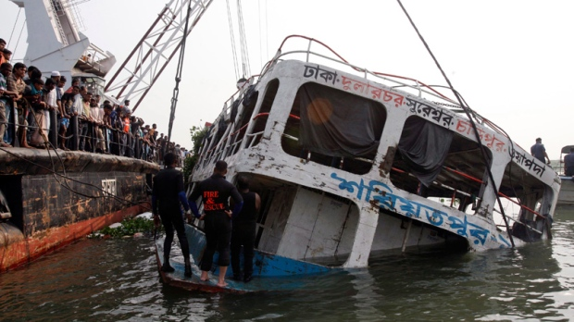
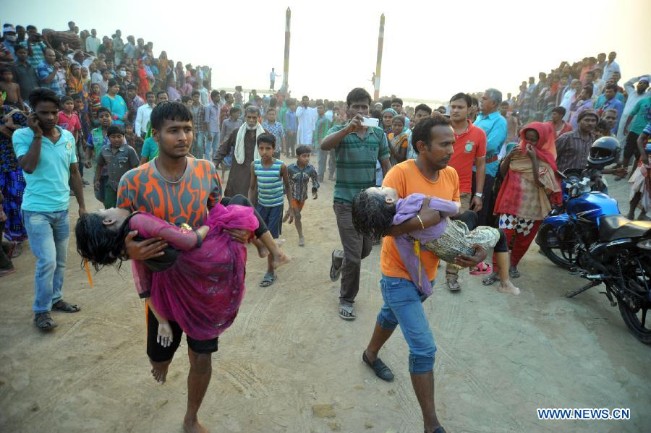
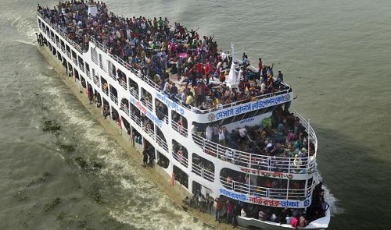

Slide 4
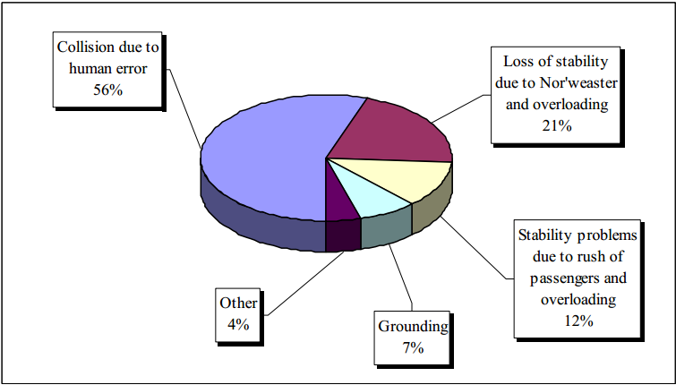
Reasons Behind these accidents

Slide 5
The proposed idea’s goal is to reduce or fully diminish the ship accidents in Bangladesh due to overcapacity. The project is divided into four main parts.
Detector
Main Base Station
Web Application
GPS Tracker

Slide 6
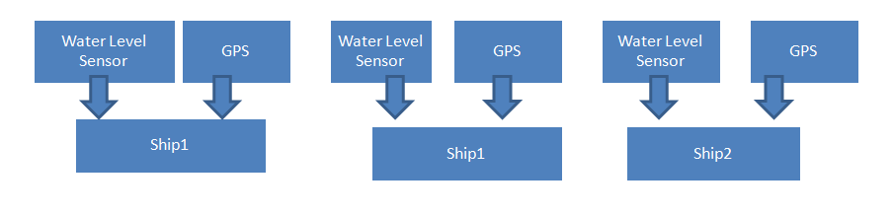
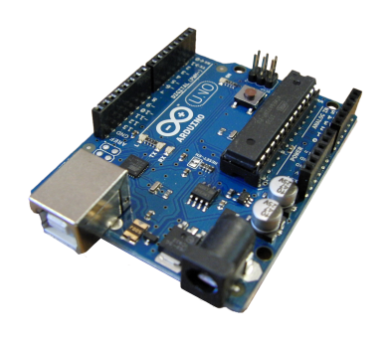

NRF
NRF
RPi
MySQL Database
PHP Script

Slide 7
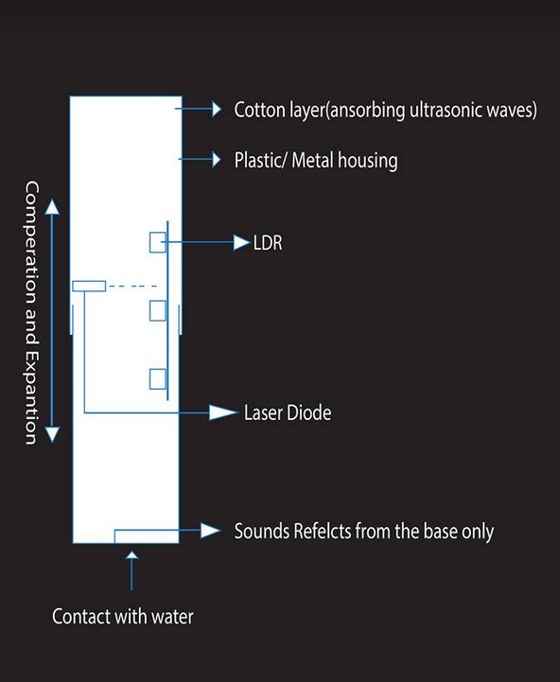
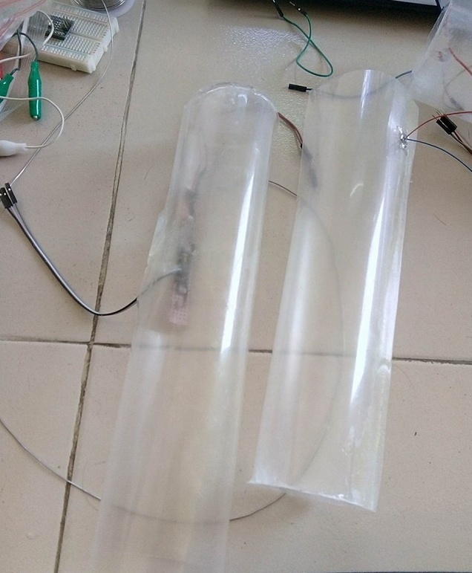
DETECTOR
sensor can detect and calculate the change in distance between it and base of the sensor and record the data as time passes by. This distance vs time can be plotted in a graph to show the situation of the boat in water. Regular peaks and falls indicated the normal behavior of the boat. By this a threshold value can set at calibration stage. If the distance read by the sonar will be less than the threshold value resulting in a conclusion of over populated deck or sinking of the boat. This scenario can be understood by the sensor circuit and will automatically issue an alarm to the controller know of the boats condition. Final point to be noted is that the water level will be detected with the help of a sensor in the cylinder.

Slide 8
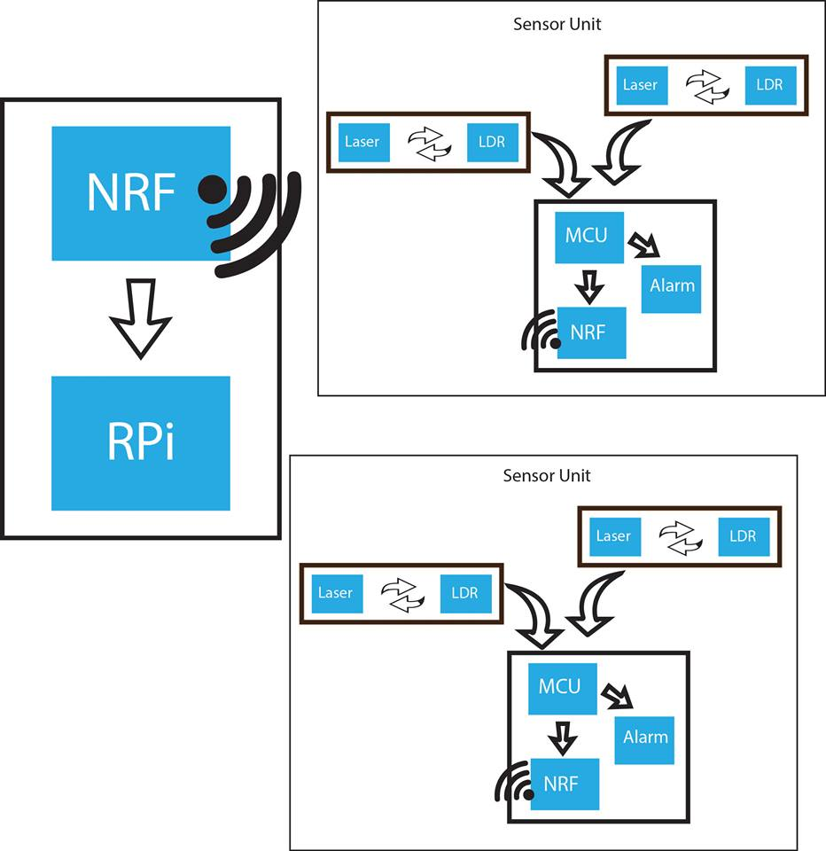

Slide 9
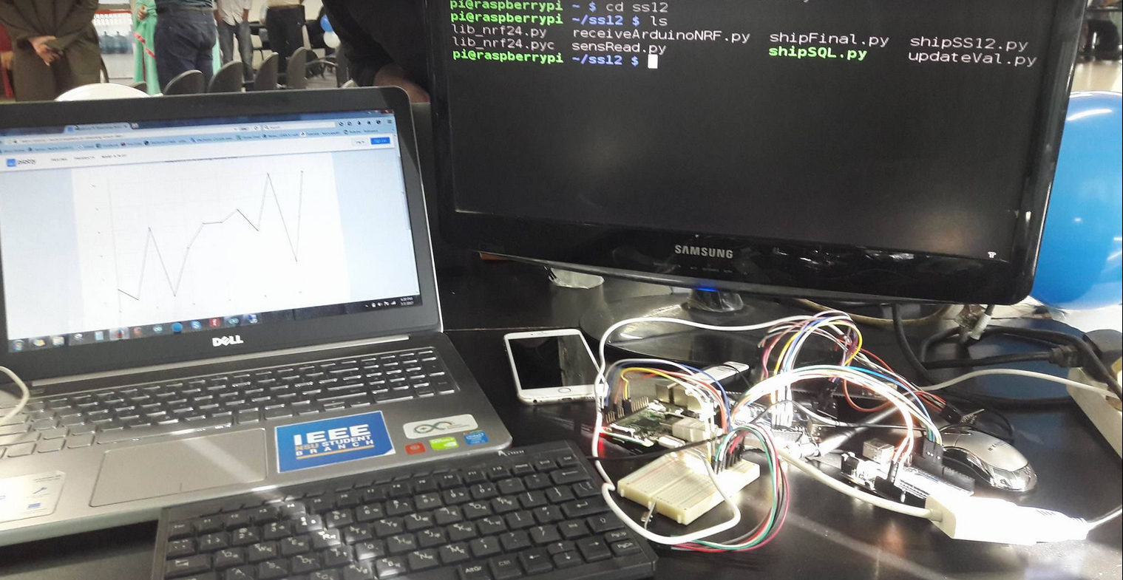
Main base station
In our main base station we will have the nrf204l receiver hooked to a raspberry pi which will get the data from multiple nodes( from different ships). Upon receiving, we will process this data and send this to a mysql database for storing purposes. The database will have the functions to read update delete from the database as the user prefers it to.

Slide 10
Web Application
In our web app we will display the data in an organized manner using html and css, the web page will always be updated and will alert the user if any abnormal situations do occur. The web page will run on our local server and we can access it from our local network. The web page will always be connected to our database so that we are always updated with new values.

Slide 11
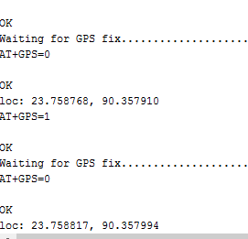
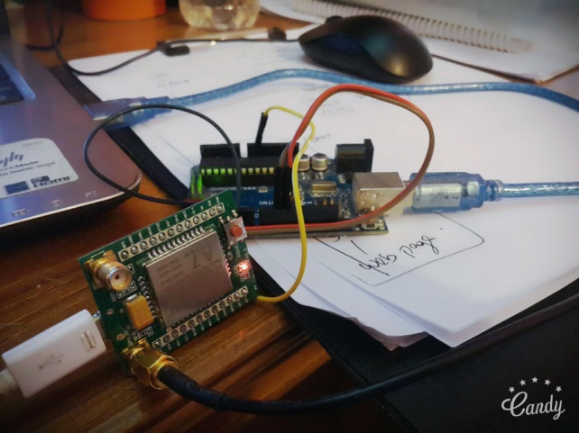
GPS Tracker
In our nodes which are connected to the ships will also be installed a GPS tracker which will be connected to the microcontroller with which we can know the location of the ships. In case of disaster, we can also track the last location of the ship.

Slide 12
Future Implementations
56% is still in human error. For example racing in the river is a common problem GPS Location gives us distance between two ships and Base station can tell if its Racing or not
User friendly UI
Socket Programming to not to have the webpage reload each time to get real time data.

Slide 13
Thank You

